Slide 2
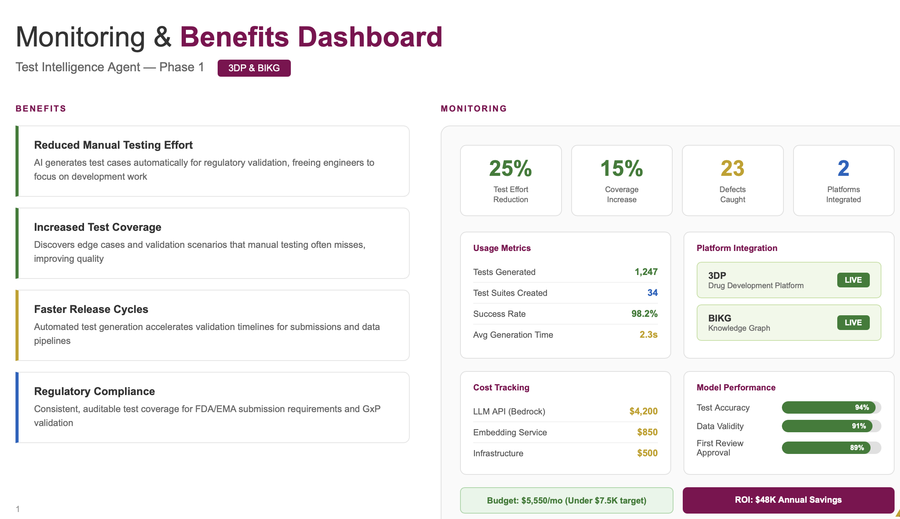
Example of Monitoring and Benefits Dashboard
Use an example for one of our four agents
Devesh

Slide 3
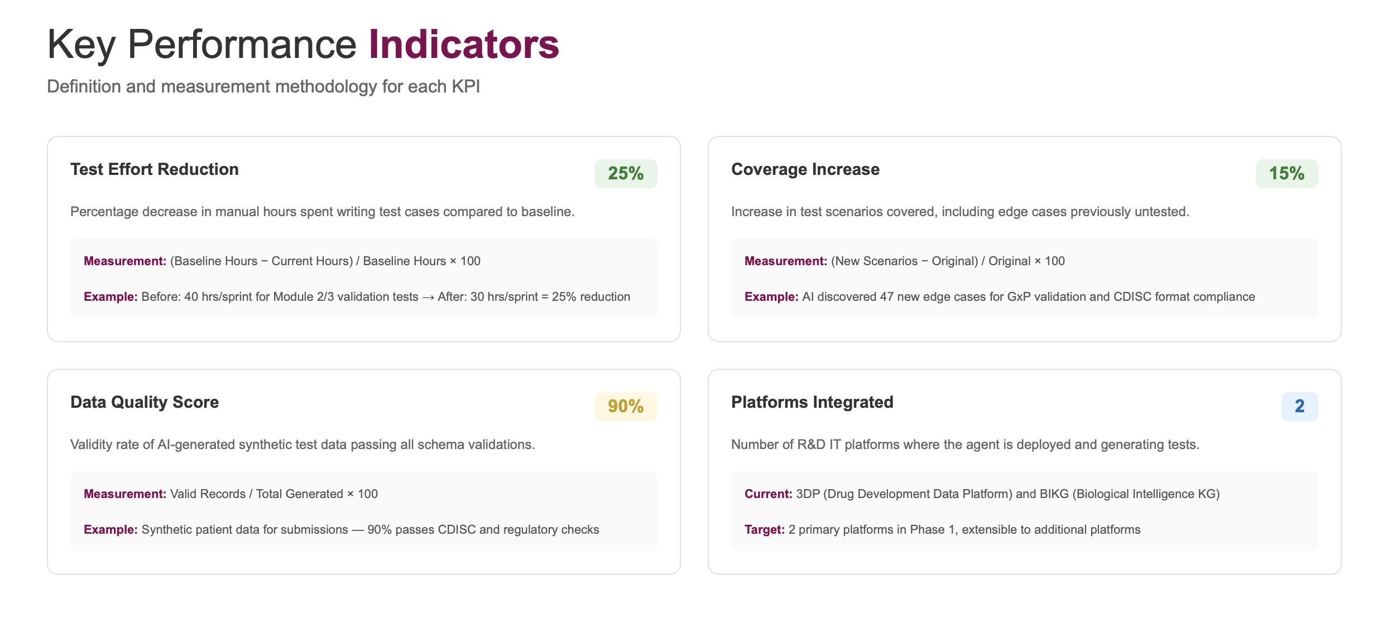

Slide 4
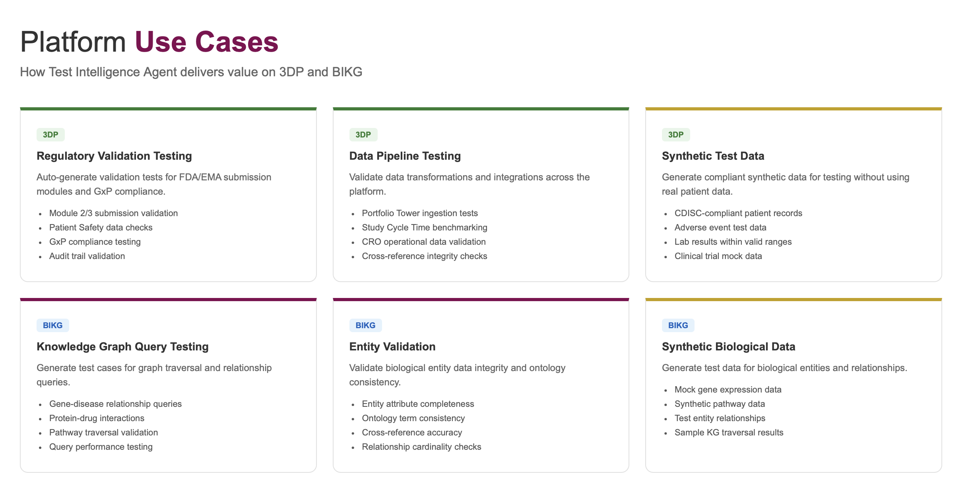

Slide 5
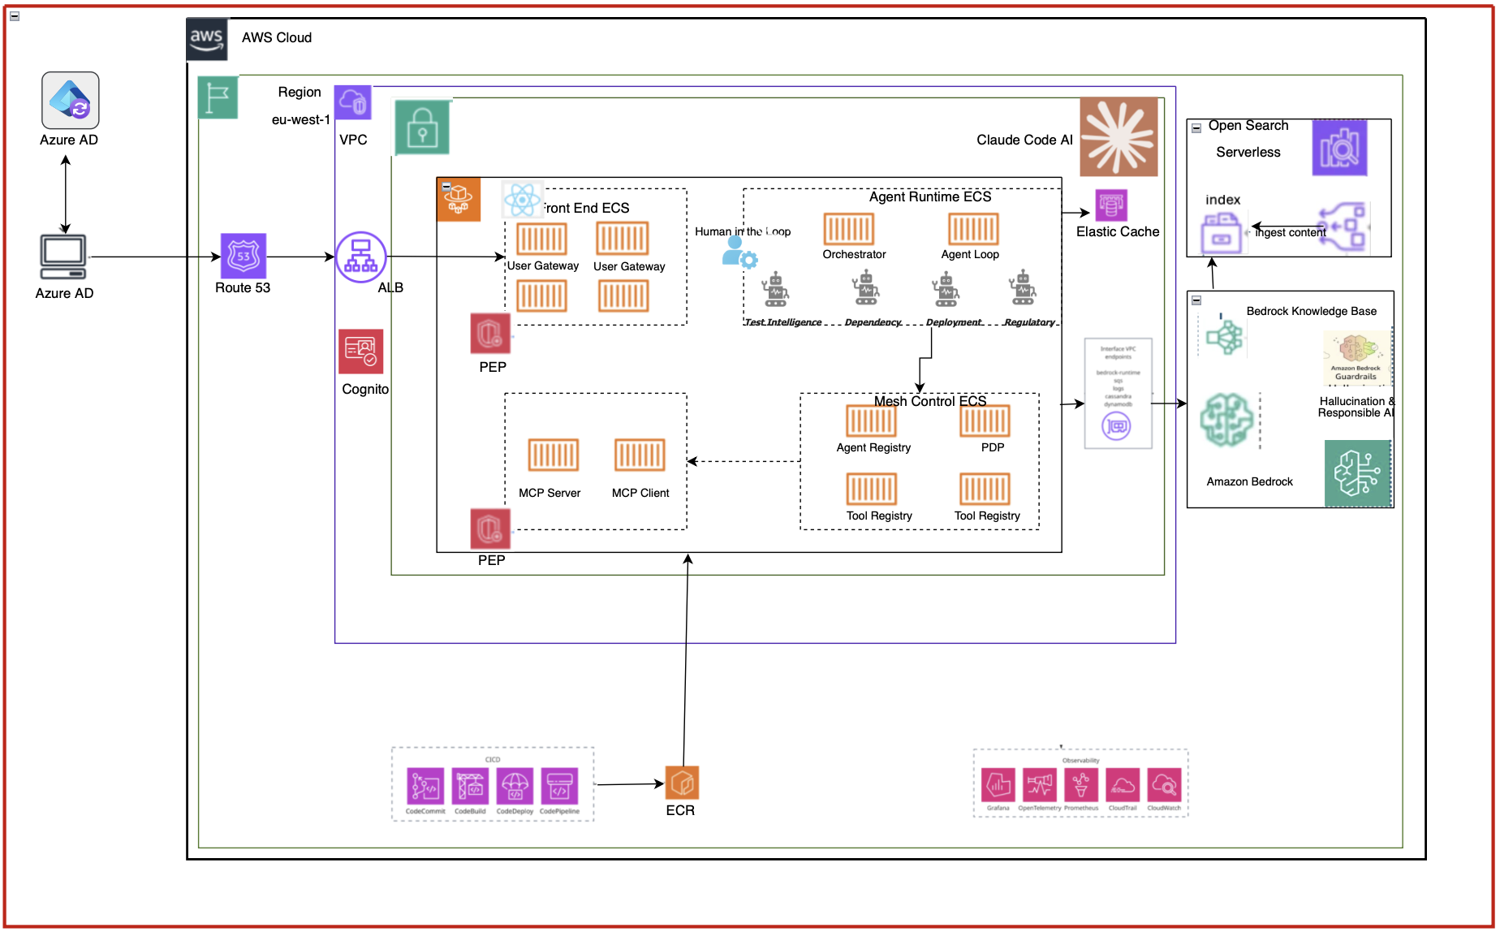
Scalable, Agent Mesh, future proof architecture for AZ’s R&D Agentic ambition
These four agents collectively form a modular R&D intelligence fabric — enabling knowledge retrieval, experiment validation, data reasoning, and governed orchestration — all operating within a secure, federated Agent Mesh architecture aligned to AZ’s Enterprise Agentic AI blueprint.
To accelerate implementation, we will leverage AI-assisted engineering (Claude Code) to generate validated scaffolding, typed contracts, test harnesses, and infrastructure templates — while maintaining full human governance, security review, and CI/CD controls

Slide 6
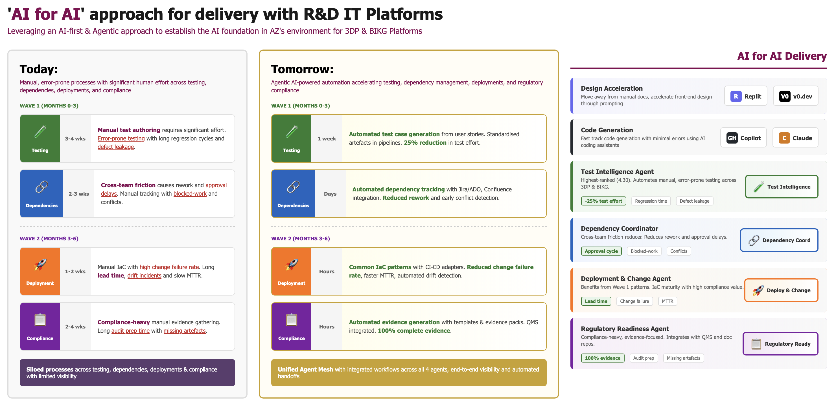

Slide 7
